Slide 1
Lagos State Government Y2021 Budget Consultative Forum
Ministry of Economic Planning and Budget
Mr. Samuel Egube
Honourable Commissioner, Ministry of Economic Planning & Budget
August, 2020

Slide 2
Outline
1
Introduction: Aims and Objectives
2
Y2020 Budget and Functional Allocation
3
Key Highlights of Half-Y2020 Budget Performance
4
Completed and Ongoing Projects
5
Our Focus Areas for the Rest of Y2020
6
Y2021 Economic Outlook: Nigeria and Lagos State
7
Priority Areas for Y2021 Budget
8
Key Strategies for Achieving the Target Revenue for Y2021 Budget
9
Conclusion

Slide 3
Introduction: Aims and Objectives
The Lagos State Government (“LASG”) is about to commence another budget cycle with a view to producing the Y2021 Budget.
In order to bring governance closer to the populace and as part of an all inclusive agenda of Mr. Babajide Sanwoolu’s administration, LASG has organised this Stakeholders’ Consultative Forum (“the Forum”).
The Forum will be held for each of the five Divisions (Ibile) to take governance closer to Lagosians.

Slide 4
Introduction: Aims and Objectives
The objectives of this Stakeholders’ Consultative Forum is to:
1
Update Stakeholders on the Half-Year performance of the Y2020 Budget
2
Inform the public of Government’s plan for the rest of Y2020 and the focus areas for Y2021
3
Obtain inputs/contributions/suggestions on the Y2021 Budget process
4
Overall, to promote citizens’ participation in budget preparation

Slide 5
Y2020 Budget
Details | 2020 Budget (₦’bn) | 2020 Half Year Budget (₦’bn)
Total Revenue | 1,071.029 | 535.515
Total Recurrent Expenditure (Debt & Non-Debt) | 457.529 | 228.764
Recurrent (debt) | 39.692 | 19.846
Recurrent (non-debt) | 417.837 | 208.918
Personnel cost | 167.907 | 83.953
Overhead cost | 249.930 | 124.965
Recurrent Surplus | 613.500 | 306.750
Total Capital Expenditure | 711.033 | 355.517
Financing – (Deficit) / Surplus | (97.533) | 48.766
External Loans | 34.533 | 17.267
World Bank - DPO | - | -
Others | 34.533 | 17.267
Internal Loans | 63.000 | 31.500
Bond issuance | - | -
Budget Size | 1,168.562 (₦Bn) | 584.281 (₦’Bn)
201
5

Slide 6
Half Year Budget Performance for 2020
Commentaries
.
Details | Budget HALF YEAR 2020 (₦’bn) | Actual HALF YEAR 2020 (₦’bn) | Performance (%)
Total Revenue | 535.515 | 432.630 | 81
Total Recurrent Expenditure (D&ND) | 228.765 | 164.428 | 72
Total Capital Expenditure | 355.517 | 170.411 | 48
Financing (Deficit) / Surplus | (48.767) | 97.792 | 201
Budget Size | 584.281 | 334.838 | 57
HALF YEAR 2020 records a budget performance of 57% (₦334.838BN); which in absolute terms is higher than the 73% (₦316.676BN) recorded for the same period in 2019.
6

Slide 7
Y2020 Revised Budget
Details | 2020 Revised Budget (₦’bn)
Total Revenue | 812.465
Total Recurrent Expenditure (Debt & Non-Debt) | 413.407
Recurrent (debt) | 13.671
Recurrent (non-debt) | 399.735
Personnel cost | 166.144
Overhead cost | 233.591
Recurrent Surplus | 399.058
Total Capital Expenditure | 507.062
Financing – (Deficit) / Surplus | (108.004)
External Loans | 34.533
World Bank - DPO | -
Others | 34.533
Internal Loans | 73.471
Bond issuance | -
Budget Size | 920.469 (₦Bn)
7

Slide 8
Functional Group Allocation of Y2020 Revised Budget
Function Group | Recurrent Expenditure | Capital Expenditure | Total Allocation | % Allocation
General Public Services | 155,385,724,497 | 77,576,216,536 | 232,961,941,033 | 25.31
Public Order & Safety | 23,871,295,326 | 12,769,184,553 | 36,640,479,879 | 3.98
Economic Affairs | 49,071,973,238 | 200,203,570,428 | 249,275,543,666 | 27.08
Environment | 23,655,374,263 | 35,347,511,996 | 59,002,886,259 | 6.41
Housing and Community Amenities | 4,026,852,135 | 26,979,672,822 | 31,006,524,957 | 3.37
Health | 71,752,978,881 | 25,932,199,441 | 97,685,178,322 | 10.61
Recreation, Culture and Religion | 4,514,626,626 | 1,349,926,145 | 5,864,552,771 | 0.64
Education | 77,755,636,997 | 37,935,852,988 | 115,691,489,985 | 12.57
Social Protection | 3,372,468,667 | 1,982,239,887 | 5,354,708,554 | 0.58
External Loans (Principal Repayments) | - | 13,057,283,910 | 13,057,283,910 | 1.42
Internal Loan (Principal Repayments) | - | 9,363,000,000 | 9,363,000,000 | 1.02
Bond Issuance (Repayments) | - | - | - | -
Consolidated Debt Service Accounts | - | 64,565,000,000 | 64,565,000,000 | 7.01
GRAND TOTAL | 413,406,930,629 | 507,061,658,707 | 920,468,589,336 | 100.00

Slide 9
Our context has changed
The Y2020 budget signed into law on Dec. 31st, 2019 reflected the administration's goals to enhance development across Lagos. It anticipated a world without COVID-19
The COVID-19 Pandemic with its resultant health and economic impacts has greatly affected the state, like other geographies around the world, and changed the context within which, we execute the development agenda
Within this very difficult context, LASG was able to achieve greater revenues, while managing expenditure, during Q1 ending March 31, 2020
Revenue stronger by >6% against approved budget, ₦282.6 billion vs. ₦267.8 billion target
Recurrent Expenditure stood at 80% of the target, while Capital Expenditure was at 41% of the objective, portending a 44:56 Capital/Recurrent ratio against the target of 61:39
Surplus of ₦119.4 billion vs planned deficit of ₦24.4 billion
There are indications the key drivers of the state's revenues would worsen over the year, and we now forecast revenue drop of 24%, requiring ~21% drop in expenditure
Revenue: IGR drop 29%, Capital Receipts drop 5%, Federal Transfers drop 30%
Expenditure: Recurrent debt increased 10%, overhead dropped 20%, CapEx dropped 28%
Deficit increased 11%

Slide 10
Current economic realities present significant downside risk to the LASG's fiscal position
1
Fall in crude oil revenue
Downward pressure on IGR
Increase in fiscal deficit
Devaluation of the Naira
Increased unemployment
Lower GDP growth
Reduced public and private investment
Increased inflation
Decline in demand for goods and services
Reduction in manufacturing activities
2
3
4
5
6
7
8
9
10

Slide 11
We need to adapt our way forward
We have re-invested significantly in the initial response to the pandemic, supporting the health response, vulnerable population and businesses
However, Lagos continues to face a high risk of unemployment, which could drive increased civil unrest, as has already been witnessed and fortunately brought under control during the lockdown.
To thrive through this crisis, we need a holistic approach that mitigates the spread of the virus, while stimulating economic activity
Maintain a strong pandemic response
Restart the Lagos State economy
Reimagine the way Lagos State operates
Consequently, it has become imperative to shift spending to activities that would support this holistic approach, which would require even further reductions in other areas
In view of the foregoing, we have decided to review the Y2020 budget from the approved amount of ₦1,168.6billion to ₦920.5 billion, while our Debt sustainability ratio remains at 14.4%.

Slide 12
LASG has implemented several interventions to minimize the impact of this pandemic
Aggressive health response
Business support measures
Relief to the vulnerable
Development of isolation centres
Development of mobile and stationary testing across LGAs
Increase of hazard and other incentives to health workers
Free basic healthcare to the public at general hospitals and PHCs
Moratorium on LSETF loans to
Tax filings extensions
Working capital to SMEs
LASG emergency food response
Conditional Cash Transfer (CCT) programs
Source: LASG Q1 2020 budget performance report, LSETF, LIRS, LASG

Slide 13
Maintain a strong
Pandemic response
Going forward, we'll take a holistic approach toward the crisis
Restart the Lagos
State economy
Reimagine the
way Lagos State operates going forward

Slide 14
Strong Response: care for Lagosians, provide economic stimulus, and ensure society runs
Food security and safety net
Economic intervention
Public safety & well being
Protect Lagos State's food supply chain
Offer shared services to farmer (e.g. fish cold rooms) to strengthen output
Provide support to farmers to boost food production
Create food banks to guarantee offtake from farmers
Pursue social intervention programs targeting society's most vulnerable
Create ingenious collaborations with private sector to drive cash transfer and feeding to vulnerable population
Promote free medical services in more neighborhoods
Provide support for Micro, Small, Medium enterprises
Provide wage subsidies based on maintaining payroll – particularly for SMEs
Enhance SMEs access to short term funding through LSETF
Consider supporting large companies in vulnerable sectors
Support non-essential service sectors to open in safe and sustainable ways
Extend tax filling and payment deadline
Waive penalty on late tax fillings
Reinforce enforcement of guidelines
Enforce containment guidelines in public places such as banks, schools, etc.
Ensure adequate distribution of protective materials, masks, hand sanitizers etc.
Prevent breakdown of law and order
Strengthen intelligence gathering capabilities
Reinforce security infrastructure

Slide 15
Restart economy: optimizes state's budget for investments in jobs and priority sectors
Job creation
Economic stabilization
Fiscal consolidation
Promote works and infrastructure
Complete ongoing drains, ward intervention, manhole cleaning etc.
Prioritize new projects based on employment and economic impact
Focus on agriculture
Finish rice mill and undertake a PPP concession afterward
Invest in comparative advantage areas (e.g. aquaculture) for quick wins
Support empowerment & training
Re-energize internship programs
Accelerate WAPA programs
Expand volunteer core initiative
Invest in priority sectors
Incentivize investments that generate employment for low skilled workers
Pursue new revenue sources
Source grant from major donor organizations
Uncover new tax opportunities
Create stabilization fund at 1% of yearly IGR to provide support to the state during future emergencies
Implementing COVID-free certification program to enable re-opening of the hospitality sector
Labor & overhead costs optimization
Contain labor costs e.g. cancel overtime, revise travel allowances etc.
Re-evaluate subventions that do not target bottom of the pyramid
Cancel non essential expenses e.g. pilgrimage, sports festivals etc.
Continue to reprioritize capex spend to match the expected ₦248B reduction in available spend

Slide 16
Reimagine Lagos: preparing the State to operate and thrive within the new reality
Digitization
Business environment reforms
Economic diversification
Complete ongoing digitization and technology projects
e-GIS project
Campus technology infrastructure project
Digital boardroom to track performance against KPIs
Learning management systems (LMS) to digitize training
Digitize state-wide processes
Push electronic platforms in health and education
Maintain investment in LASRRA as identity remains key to economic
Continue to develop infrastructure to enable a digitized Lagos State (e.g. broadband and smart city efforts)
Promote ease of doing business
Promote initiatives that simplify business compliance processes
Enable businesses to have better access to government
Improve process to secure land titles
Build capacity of relevant agencies
Invest in training of relevant agencies
Incentivize agencies to drive reforms
Increase transparency of food markets to drive safety, reduce wastage, & enable a strategic food reserve
Drive regular updates to ExCo on ongoing reform efforts
Tap into growing digital economy in the state
Build innovation and co-creation hubs in partnership with tech organizations
Support Fintech and other technology companies through incentives
Encourage and improve quality of STEM education in public schools

Slide 17
The holistic approach drives differential investment in select sectors (I/II)
The provision for Expenditure in this Sector has gone up significantly because the ₦20bn earmarked for intervention on COVID issues are mainly been spent in this Sector.
The Construction of New Massey Children Hospital and of The Lagos State Infectious Disease Research Center will also be given adequate attention among others.
We have kept Health budget at the pre-COVID budget estimates
Health
School rehabilitation and the Eko Equip program to continue.
Dedicate ₦3Bn behind the Education Trust Fund
Invest in the Job initiative Lagos ₦620Mn and the Digital skills initiative ₦385Mn
Kept the budget for Quality assurance to ensure quality in a changing landscape ₦200Mn each for Capex and Recurrent expenditure
Education
There is plan to implement many road and transportation projects to reduce cost of transportation, improve travel time and create job opportunities, for both formal and informal sectors, e.g. Last Mile bus scheme ₦4.8Bn
Expanded the Drainage budget by ₦1.6Bn to accommodate concrete lining of Akinola river/Aboru Alimosho.
Aligned the Infrastructure budget with the bond funded projects, meaning ₦97Bn of our project are already funded materially and prioritized. For example: Regional Road ₦20Bn
Works & Infrastructure

Slide 18
The holistic approach drives differential investment in select sectors (II/II)
The State will embark on programmes and projects geared towards making Lagos Self sustainable in food production. Focus on areas of competitive advantage e.g. Aquaculture ₦500Mn
Greater support will be provided for the small and medium scale farmers, while the proposed establishment of aqua-culture, whole-sale food market and the strategic food reserve will be implemented.
Committed to finishing the rice mill which will be funded by ₦8Bn CBN loan
Complete the Lagos food production centre Avia, Igborosu Badagry ₦1Bn
Pursue a methodical food market policy that support whole sale food markets to attract investment in our food markets and strategic food reserves. ₦2Bn
Agriculture
There will be deliberate increase in activities towards establishing more Industrial Hubs.
The Administration shall also support more wealth creation (equipment support), skill acquisition, capacity building and improving upon the employability skills for the youth and women - Volunteer corps to employ volunteers, Internship programs, Skill acquisition for Women, Vulnerable and Indigent Citizen in the 57 LGAS/LCDAS
Support MSMEs in the Tourism space deliberately
Intervene through LSTEF in loans to the sector based on clear risk acceptance criteria LSTEF capacity has been increased to ₦4.8Bn
Committed ₦800Mn to training and skill acquisition in the entertainment and hospitality sector
People empowerment

Slide 19
ECONOMIC OUTLOOK FOR Y2021

Slide 20
Forecasts suggest 2020 GDP growth will be severely impacted followed by a sharp rebound
State GDP growth forecast (%)
+15%
Affects employment & IGR
2020
2021
2022
2023
Source: Lagos Bureau of Statistics

Slide 21
Consumption expected to grow at 4% p.a., in line with national GDP growth forecasts
Nigerian Consumption forecast (₦Tn)
+4%
Impacts VAT & Fed Allocation
2020
2021
2022
2023
Note: Nigerian consumption assumed to grow in line with national GDP
Source: Economist Intelligence Unit

Slide 22
Analysts expect Brent to average $40/barrel in 2020, then gradually increase to $60 by 2023
Crude oil (Brent) price ($/barrel)
+14%
Impacts Federal oil revenue & Fed. Allocation
2020
2021
2022
2023
Source: Fitch Solutions

Slide 23
Oil production fixed between 2020 and mid 2022, to meet OPEC quotas, then set to rebound to pre-OPEC volumes of 2.2mbpd
Crude oil production (mpbd)
+14%
Impacts Federal oil revenue & Fed. Allocation
2020
2021
2022
2023
Source: Ministry of Petroleum Resources

Slide 24
Revenue forecasted to grow by 9% p.a. over medium term driven by IGR
LASG 2019 – 2023 Revenue (₦ M)
2020 – 2023 CAGR (%)
+9%
1,063
905
71
Capital Receipts
-31%
812
846
64
165
+8%
66
Federal Transfers
623
220
158
157
13
214
129
Internally Generate Revenue
+21%
684
827
463
622
396
2019A
2020F
2021F
2022F
2023F
Source: Economic Intelligence Unit (Historical Data)

Slide 25
Expenditure forecasted to grow at 10% p.a., with a capex : recurrent expenditure ratio ~1
LASG 2019 – 2023 Expenditure (₦ M)
2020 – 2023 CAGR (%)
+10%
1,225
1,054
126
Repayment
+5%
920
974
93
110
73
707
534
Recurrent Expenditure
+9%
147
453
487
412
324
Capital Expenditure
399
448
474
565
+12%
236
2019A
2020F
2021F
2022F
2023F
CapEx-Recrurrent ratio
0.97
0.99
0.97
1.1
Source: Economic Intelligence Unit (Historical Data)

Slide 26
Completed and Ongoing Projects
Ongoing Projects
Construction of flyover @ Agege – Pen cinema
Construction of Badagry Expressway
Completion of Isawo Road, Ikorodu.
Completion of Bola Ahmed Tinubu Road, Ikorodu.
Establishment of the Lagos Food production centre and the Lagos Aquaculture Centre of Excellence.
Graduate Internship Programme Placement
Continuous Lagos Agriprenurship Training Programme
32 MTPH Rice Mill at Imota

Slide 27
32MTPH Rice Mill at Imota
The project is 75% completed.
The Mill when completed will produce 120,000MT Rice annually
Increase local Rice production by 75%
Create of over 300,000 job opportunities along the value chain;
Effort is ongoing to train Rice farmers in the State on the right variety of rice to produce to fed the Mill

Slide 28
Construction work ongoing at the Rice Mill Site

Slide 29
Construction work ongoing at the Rice Mill Site

Slide 30
Construction work ongoing at the Rice Mill Site

Slide 31
Empowered farmers: through programs that target farmers, youths & women
1. Agricultural Youth Empowerment Scheme (Agric-YES)
15,000 Women and Youths would be trained and empowered in various agricultural value chains especially poultry, aquaculture, rice, piggery and vegetable production
Project would be revamped in the next four years
2. Agro-processing Productivity Enhancement & Livelihood Improvement Support Project (APPEALS)
10,000 farmers would be trained towards large scale production & processing of rice, eggs, poultry and fish in this World Bank assisted program
35% of beneficiaries will be women while 10% would be people living with disabilities & youths
750 youths have been trained & empowered with agricultural inputs in rice, poultry & aquaculture
3. 2019 Agricultural Value Chains Empowerment
This is targeted at farmers and at service providers and suppliers within the system whose services are required for the successful implementation of the project
1,750 households were empowered with Agricultural productive assets and inputs in the year 2019’s edition of the project
4. Lagos Agripreneurship Programme
15,000 youths & women would be trained in various value chains by year 2023
This is a one-month training of 200 participants aimed at improving capacity, creating wealth and employment in agricultural value chains
We expect at least 2000 Agro-Entrepreneurs would become job creators and 4000 indirect jobs will be created
5. Empowerment of 40 youth fish farmers in cage culture farming
40 youth fish farmers in Badagry were trained in fish cage system & empowered with 40 Cages of 1,000 juvenile catfish per cage
The cage system is an environmental friendly way of increasing fish supply in the state

Slide 32
Lagos Agriprenurship Programme
To promote employment generation for youths in the State through Agriculture, the Ministry plan to train 2,000 youths annually under this scheme
So far 200 Youth Agriprenurs trained in various Agricultural Enterprises.

Slide 33
Also, the Ministry through its World Bank Assisted Agro-processing, Productivity Enhancement and Livelihood Improvement Support Project (APPEALS) has trained and supported over 500 Youths and women in the 3 value chain of Aquaculture, Poultry and Rice Value Chain.

Slide 34
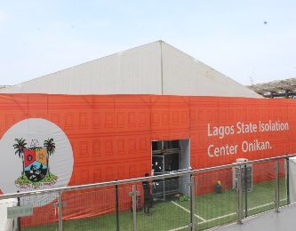
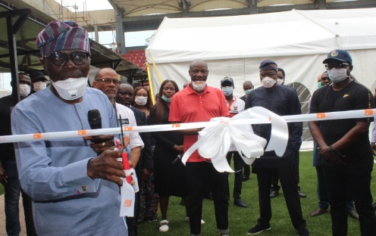
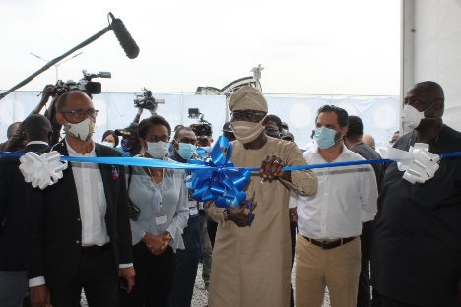
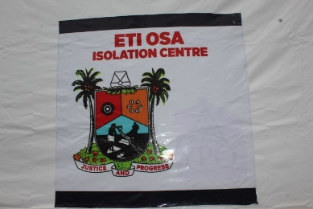
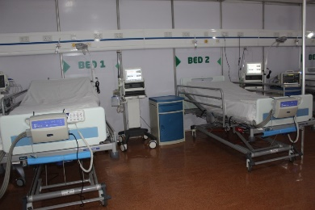
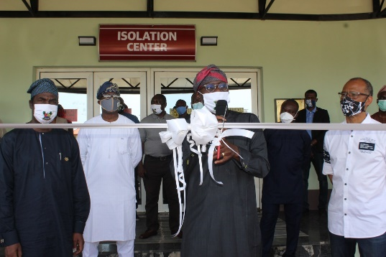
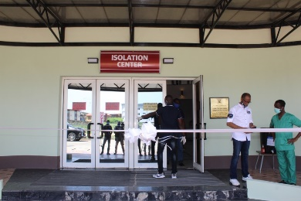
Early activation of the Incident Command System on COVID-19 Construction and Commissioning of 110-bed Onikan Isolation Centre; a PPP Initiative in collaboration with GTB and other partners Construction and Commissioning of Eti-Osa (LandMark) Isolation Centre; a PPP Initiative in collaboration with YPO Construction and Commissioning of Gbagada Isolation Centre
COVID-19: State has maintained strong response since inception

Slide 35
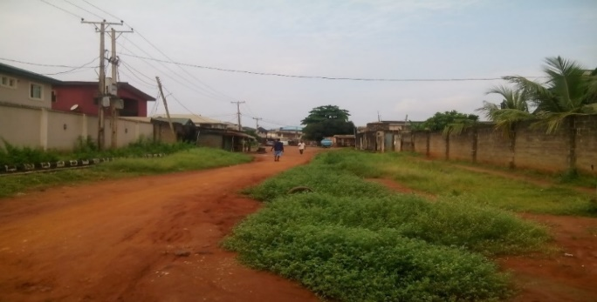
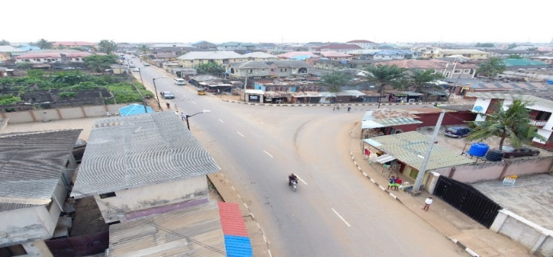
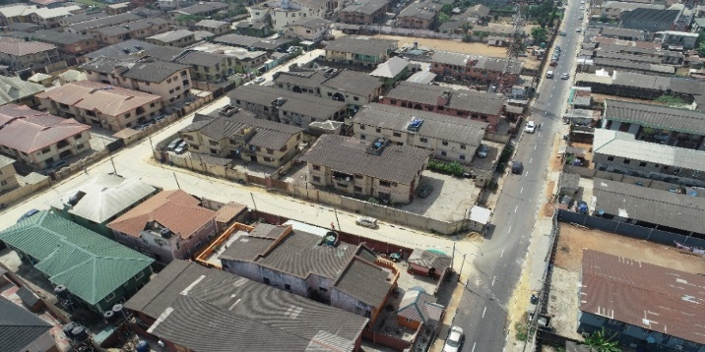
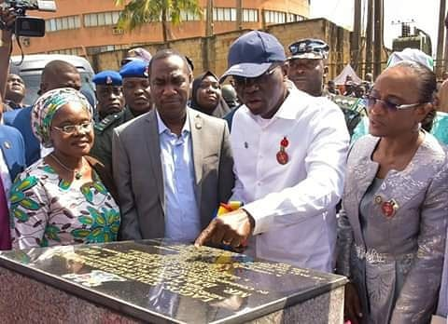
31 NETWORKOJOKORO State Government has completed and commissioned 31 networks of roads In Ojokoro LCDA. The completion of this road has offered traffic relief to the area, improve the socio-economic activities and improve connectivity within the axis and neighbouring Ogun State
BEFORE
The 13.701 km. length network of which are in two phases with 31 streets roads are presently providing major by-pass/alternate route to Lagos-Abeokuta Expressway.

Slide 36
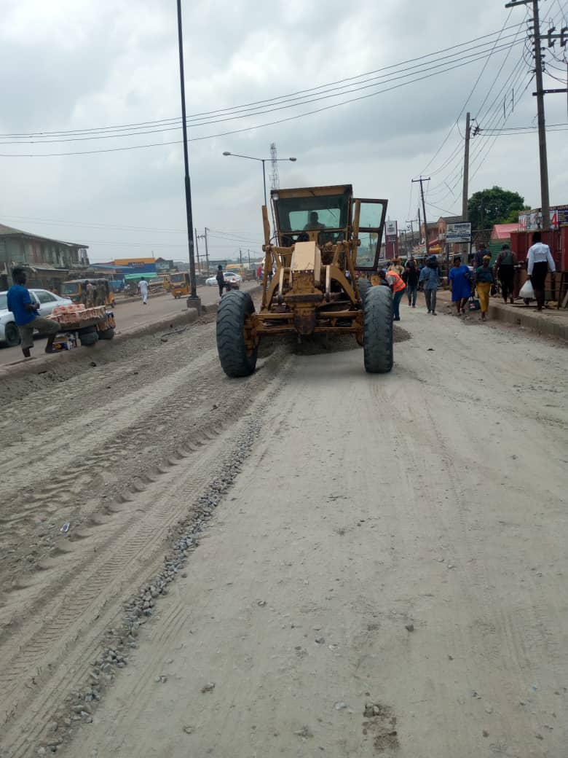
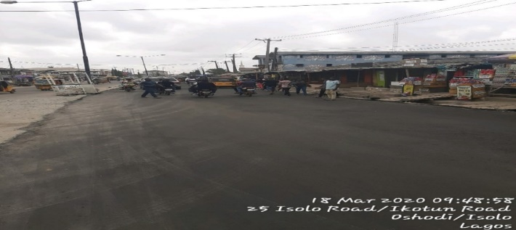
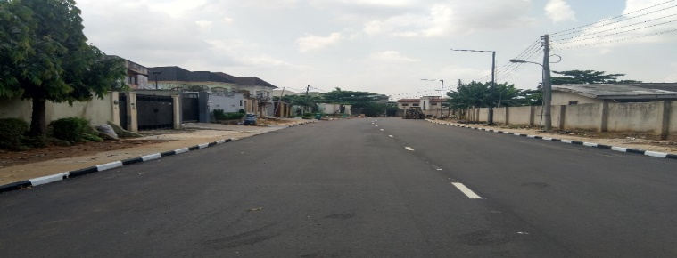
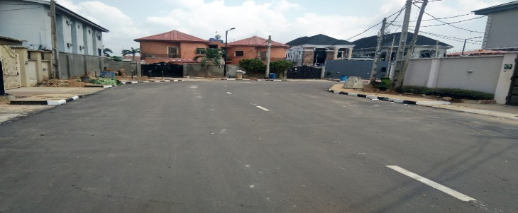
IYANA ISOLO ROAD - OKE AFA - EGBE - IKOTUN ROAD, OSHODI-ISOLO LG (COMPLETED)
DURING SPREADING OF STONE BASE
LAYING OF ASPHALTIC PAVEMENT
CONSTRUCTION OF MORADEUN ALABI CRESCENT, MAGODO G.R.A PHASE II (COMPLETED)
DURING RECONSTRUCTION
AFTER ASPHALTIC PAVEMENT

Slide 37
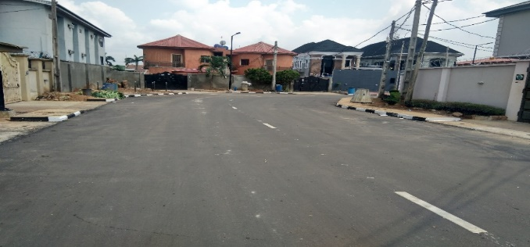
IYANA ISOLO ROAD - OKE AFA - EGBE - IKOTUN ROAD, OSHODI-ISOLO LG (COMPLETED)
DURING SPREADING OF STONE BASE
LAYING OF ASPHALTIC PAVEMENT
CONSTRUCTION OF MORADEUN ALABI CRESCENT, MAGODO G.R.A PHASE II, (COMPLETED)
DURING RECONSTRUCTION
AFTER ASPHALTIC PAVEMENT

Slide 38
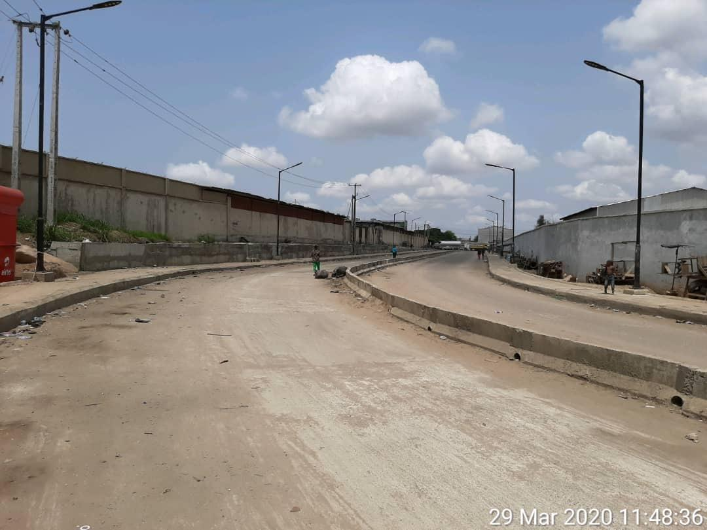
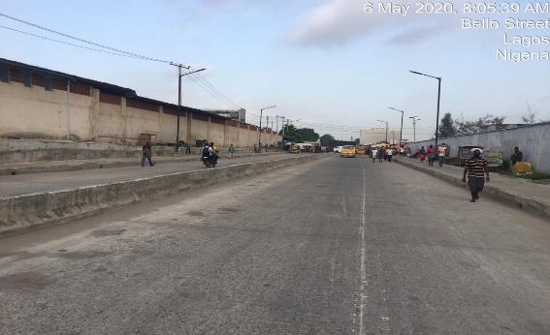
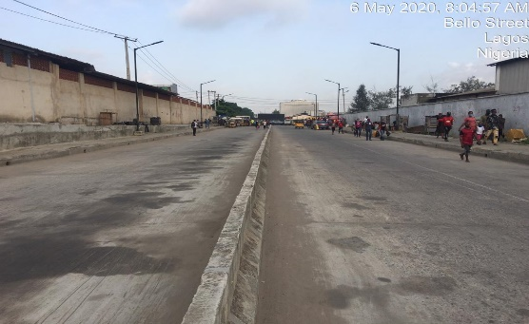
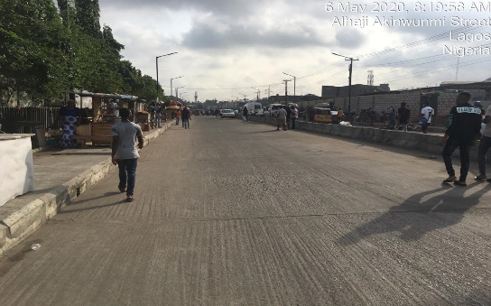
REHABILITATION / UPGRADING OF ALHAJI AKINWUNMI STREET IN MUSHIN L.G.A (COMPLETED)
Recently completed Alhaji Akinwunmi Street. Akinwunmi Street is a complete rehabilitation with a length of 16.4m. It’s a dual carriage way with reinforced concrete pavement of 200mm thickness, 1m x 1m drains and walkway on both sides. It traversed from Ladipo Street Intersection and terminates at Apapa/Oshodi
Nov 21, 2019 1:10:34 PM
Nov 21, 2019 1:10:34 PM

Slide 39
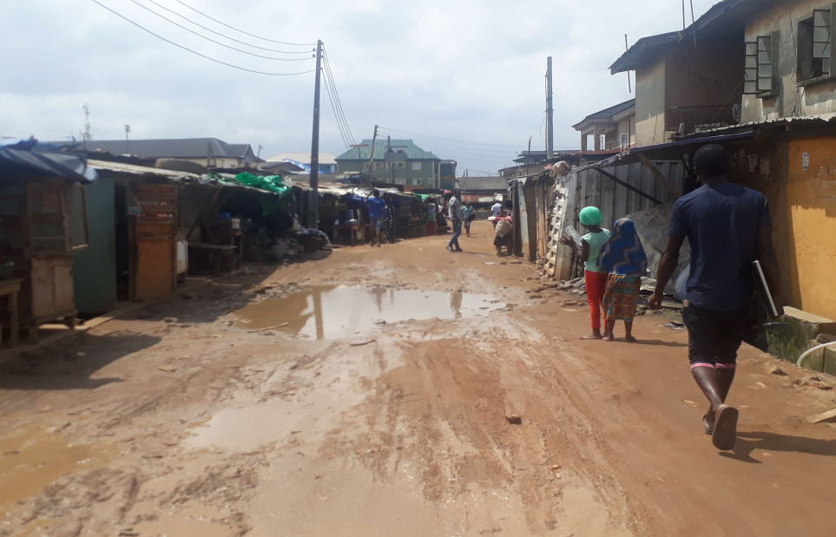
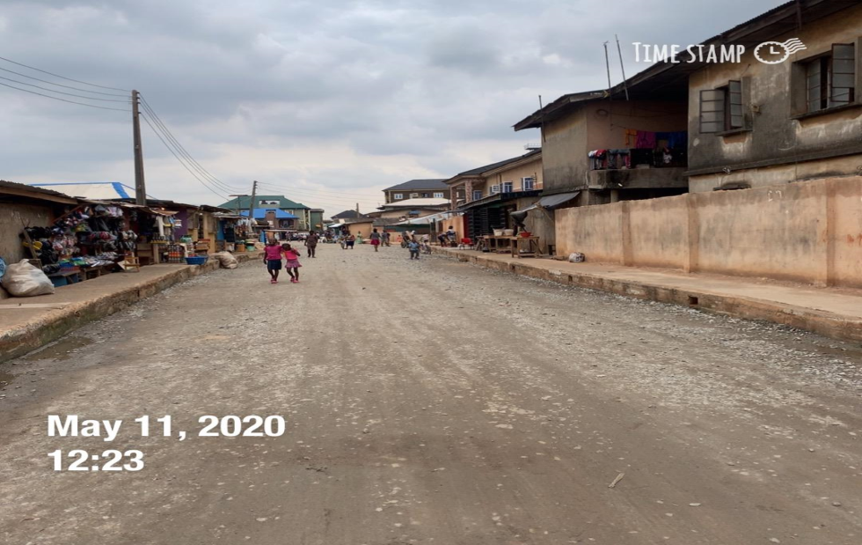
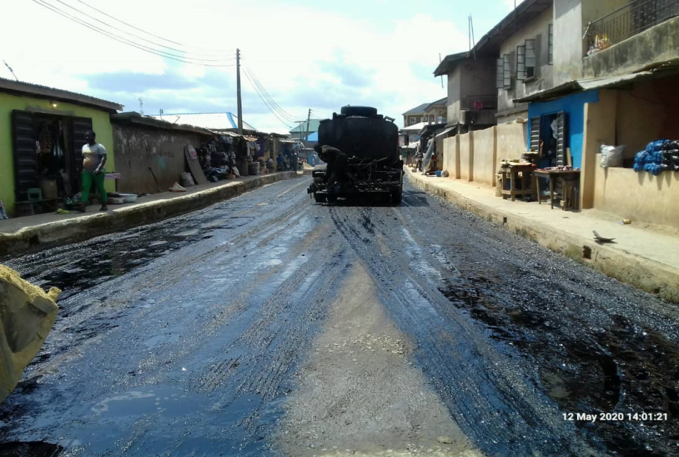
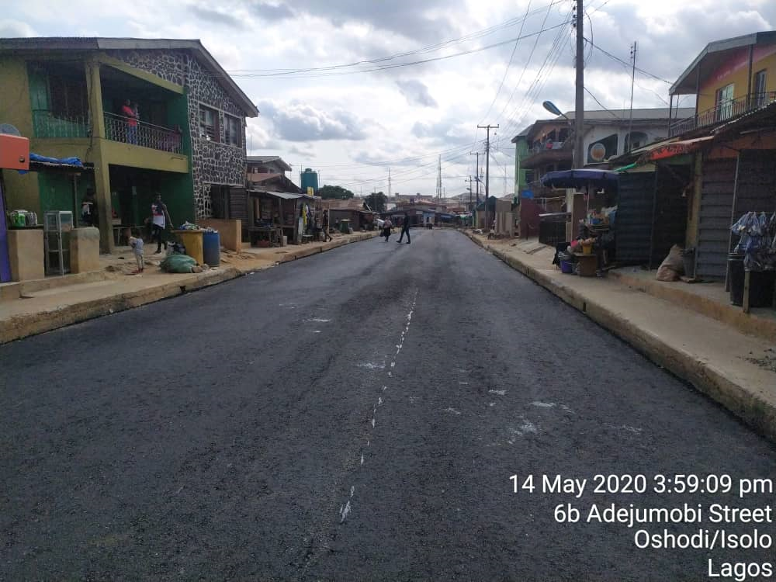
CONSTRUCTION OF AGO-IJAIYE/ADEJUMOBI/ISHOLA DANIEL STREET, ORILE OSHODI IN OSHODI-ISOLO LOCAL GOVT AREA
July 17, 2020
12:34
ADEJUMOBI STREET BEFORE
BASE COURSE IN PLACE AT AADEJUMOBI STRRET
May 23, 2020
12:34
June 09, 2020
15:35
SPRAYING OF MCI AT ADEJUMOBI
ASPHALTIC CONCTRET AT ADEJUMOBI STR.IN PLACE

Slide 40
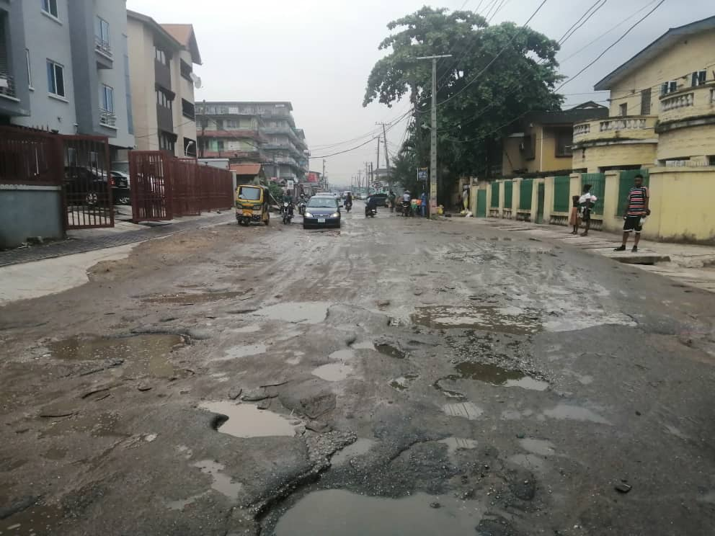
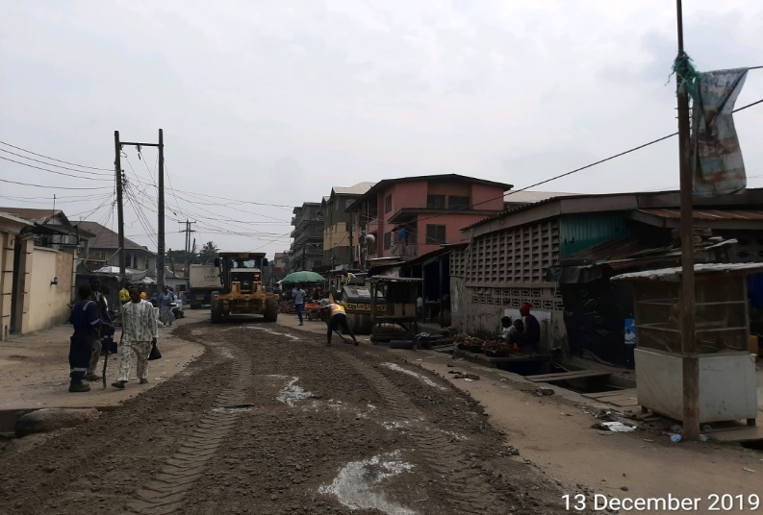
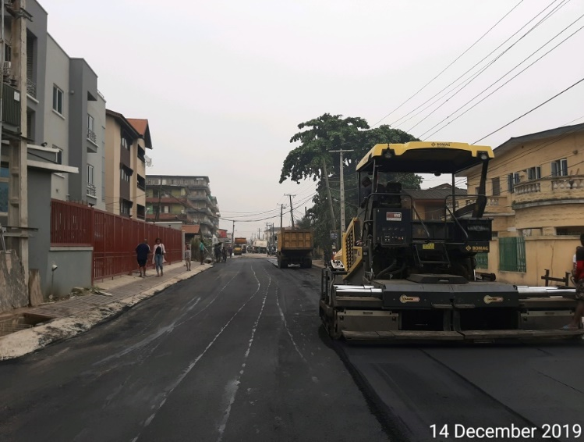
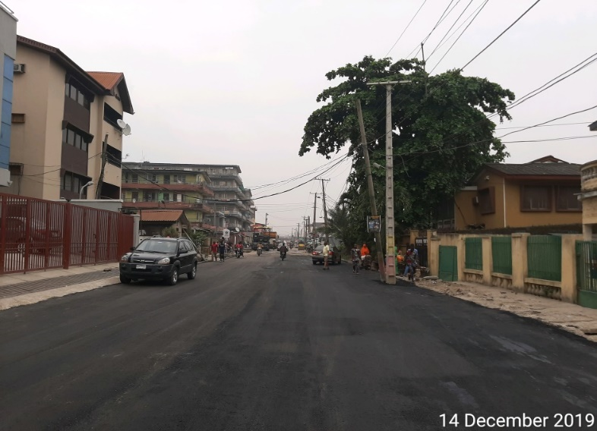
STRATEGIC PHOTOGRAPHS OF WORK DONE ON BAJULAYE STREET, SOMOLU L.G.A
EARTH WORKS IN PROGRESS
BEFORE
ASPHALT WORKS IN PROGRESS
COMPLETED ROAD SECTION

Slide 41
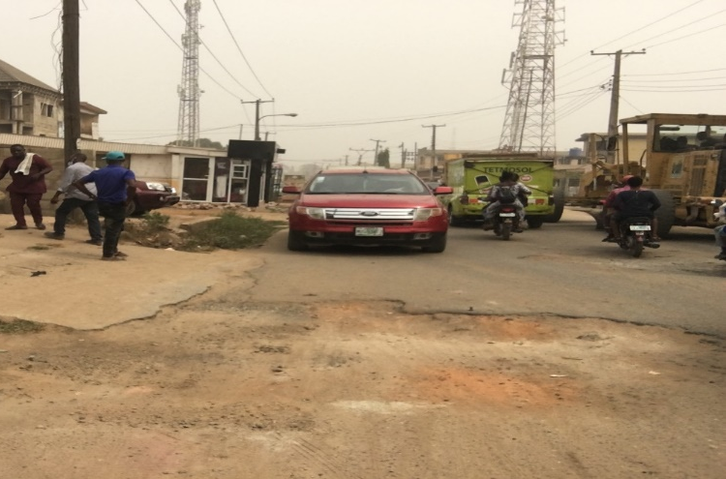
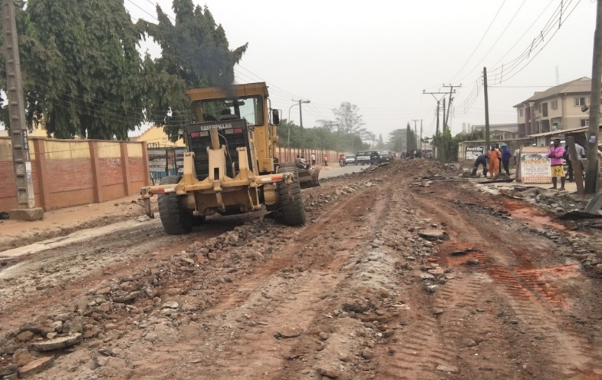
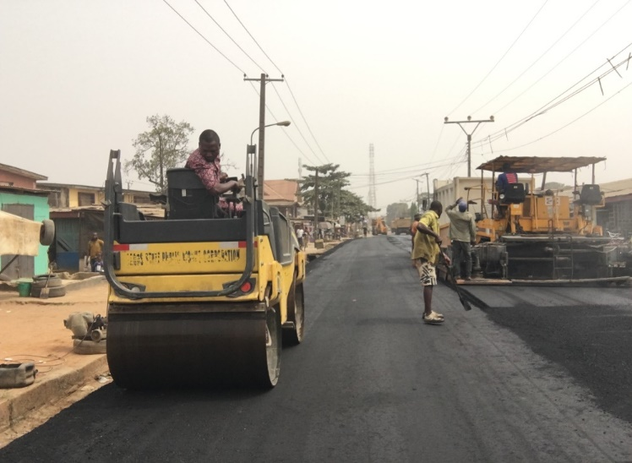
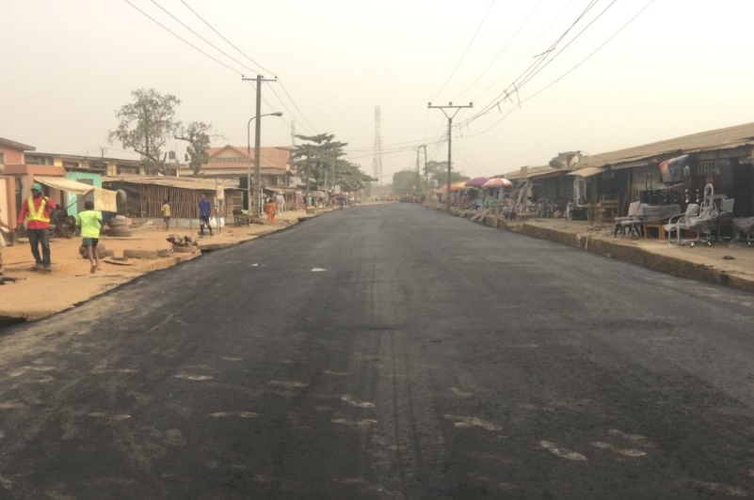
STRATEGIC PHOTOGRAPHS OF WORK DONE ON OBA OMOLAJA,
IKORODU L.G.A
EARTH WORKS IN PROGRESS
BEFORE
ASPHALT WORKS IN PROGRESS
COMPLETED ROAD SECTION

Slide 42
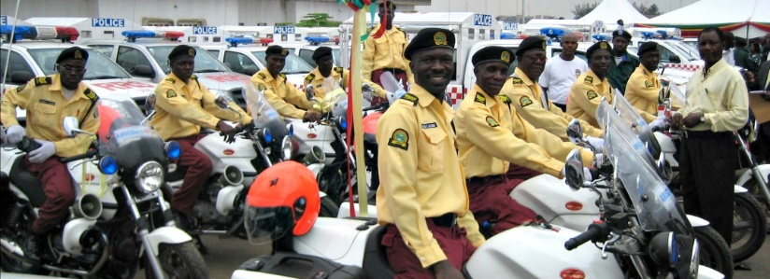
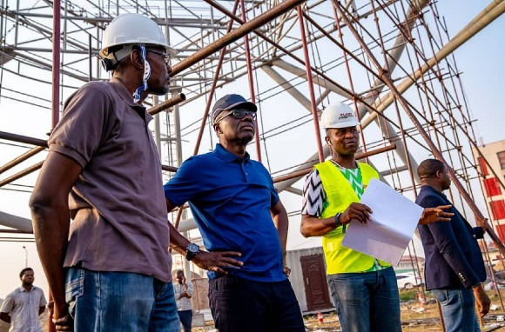
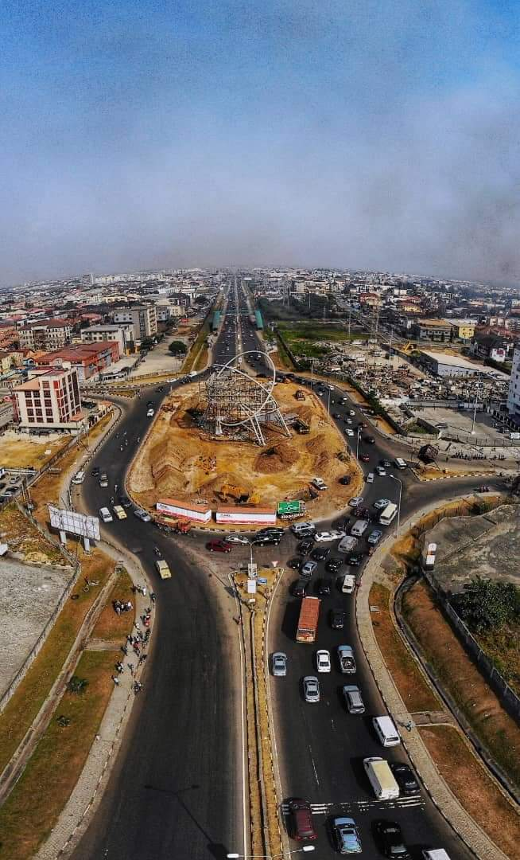
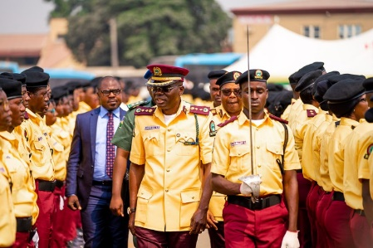
Resolved 60 identified gridlock points across the State in collaboration with the traffic taskforce team
Traffic Management: Focus on reducing traffic congestion and enhancing enforcement of traffic laws
Converting 6 critical junctions and roundabouts into synchronized signalization to increase vehicular capacity
Acquired 15 vehicles and 26 motorbikes to support the efforts of the traffic enforcement taskforce
Recruited 1000 trained LASTMA officials to boost traffic control and management
Extended shift duty hours of LASTMA officials to 10pm

Slide 43
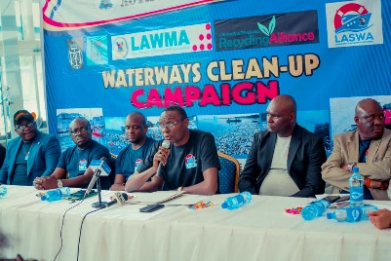
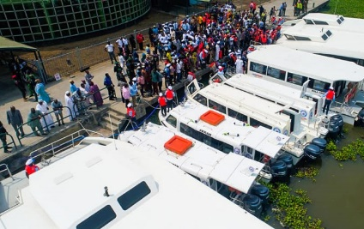
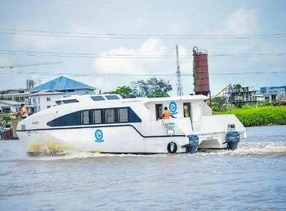
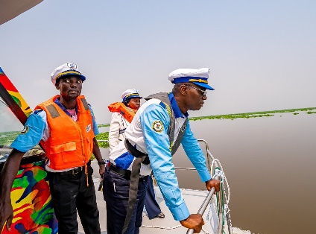
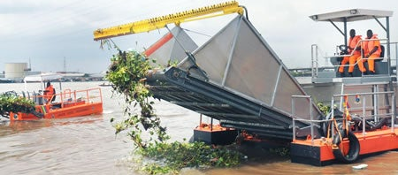
Public transport management: Expanded capacity of water transport and improved safety measures
Acquired 6 new LAGFERRY boats increasing the number of boats from 8 to 14. Now commuting average 800 passengers daily across all routes
Unveiled 180 tons barge, with 150 people capacity for social events
Regular waterways clean up and clearing of water hyacinth clusters and all other impediments to guarantee safety on the waterways

Slide 44
Partnership: nurtured strategic relationships with various partners to Ministry's mandate
Coordination of Federal Government N-Power Programme in the State – almost 23 thousand youth are benefiting through the N-Power modules - N-Teach, N-Agro and N-Health – and are engaged in various primary schools, primary health centres and as agricultural extension workers
Enrolment of beneficiaries for Conditional Cash Transfer (CCT) – The State Government approved the establishment of the State Cash Transfer Unit (SCTU) and 8,147 beneficiaries have been cleared and should begin receiving their N5000.00 monthly, per household shortly
Lagos State Employment Trust Fund - supported 2,204 businesses as follows with loans - 1167, employability offerings -967 and Lagos Innovates -70. Also successfully organised an employment summit in February 2020 to enable peer learning, influencing of public policy, etc
USADF Capacity Building Programme - completed the first phase of grant signing for the USADF Youth-Led Enterprise, a $10 million matching fund aimed at impacting over 15,K youths in Lagos State with skills & internships

Slide 45
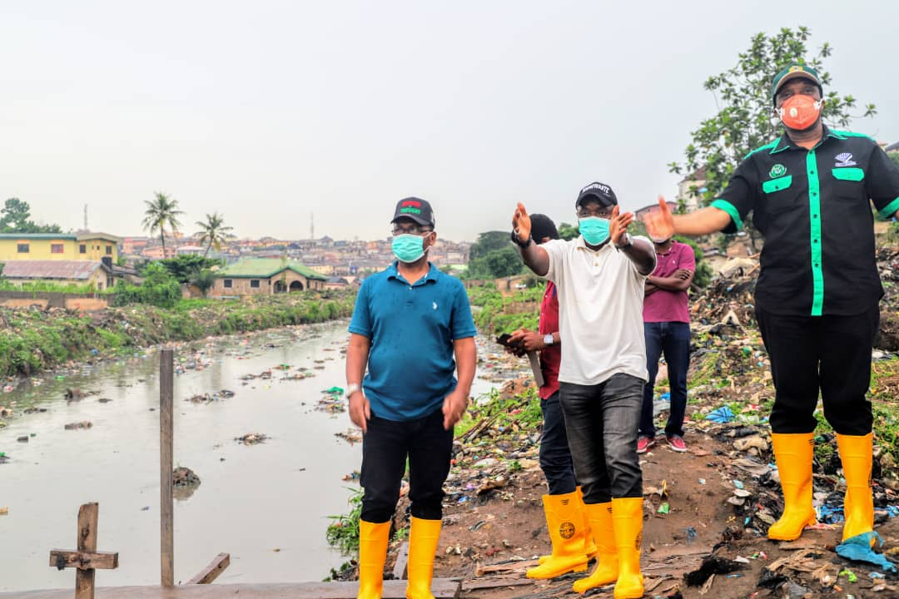
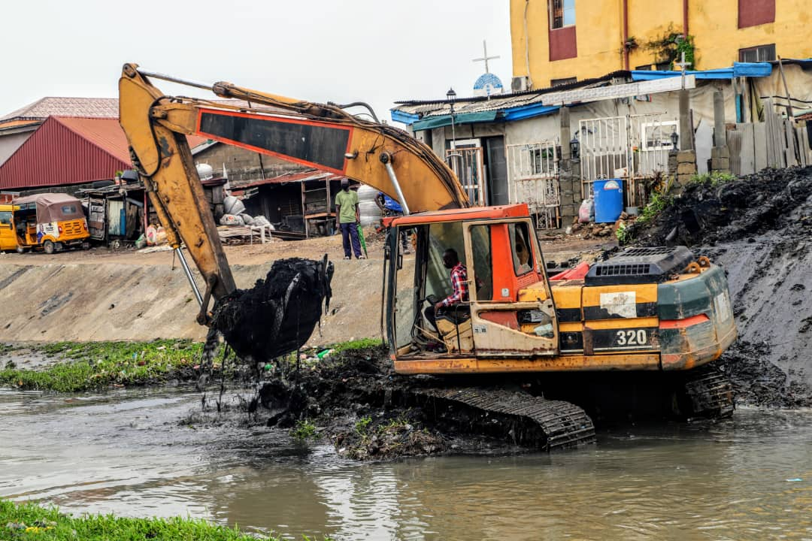
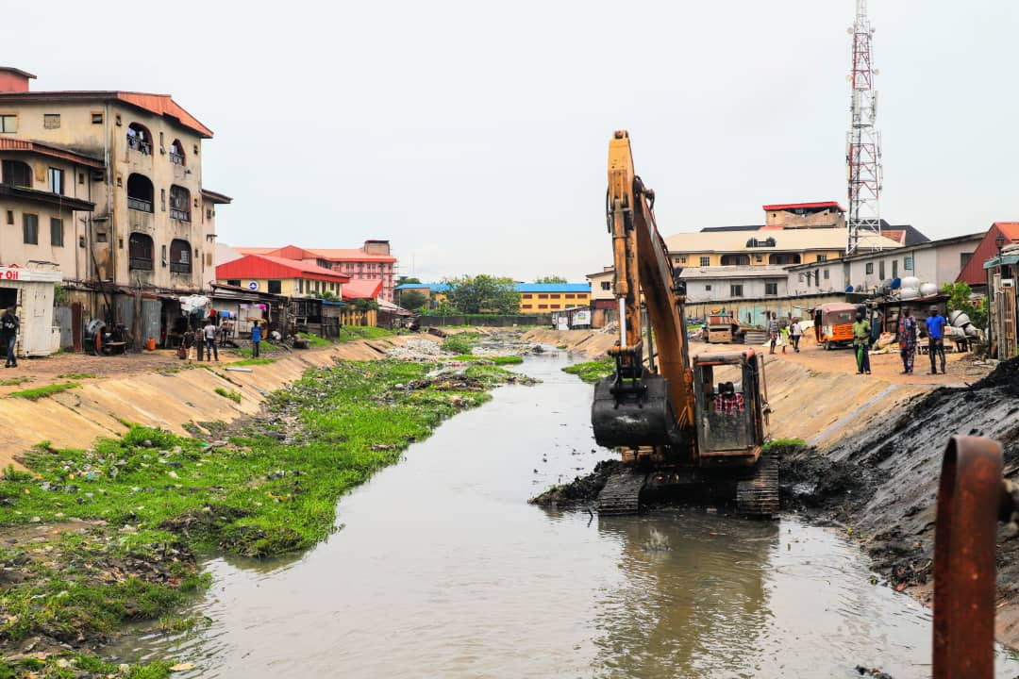
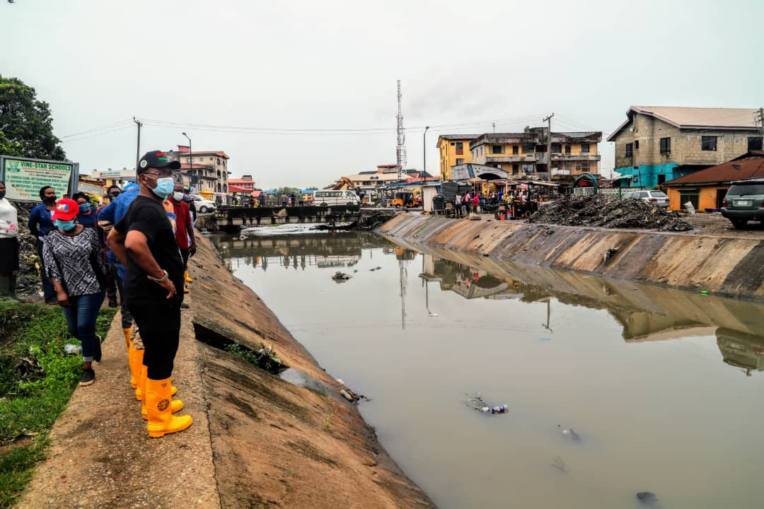
MINISTRY OF THE ENVIRONMENT AND WATER RESOURCES
OFFICE OF DRAINAGE SERVICES
Ongoing dredging and clearing project of Canals and Drainages
.

Slide 46
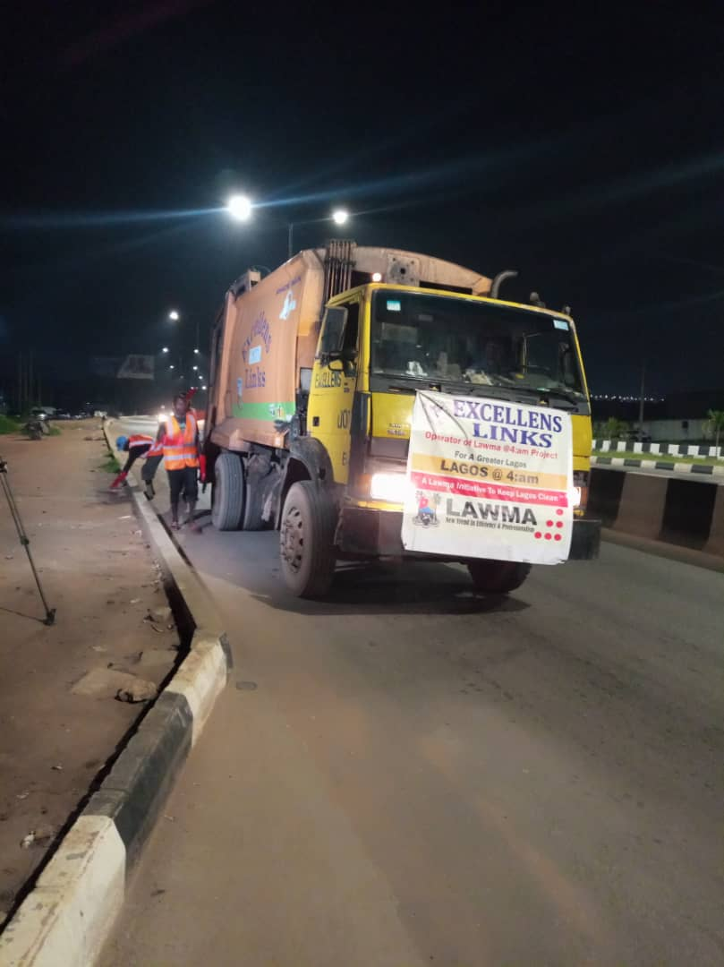
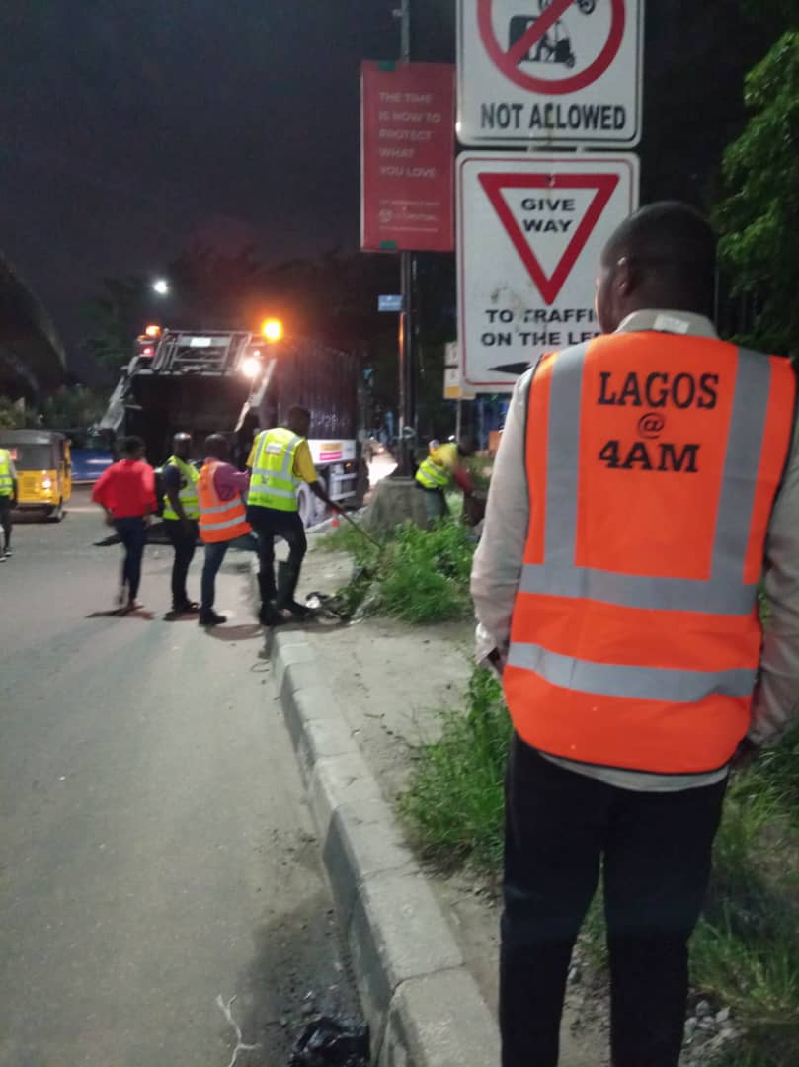
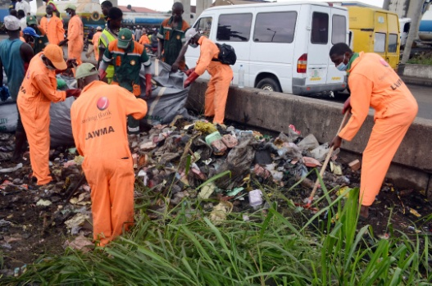
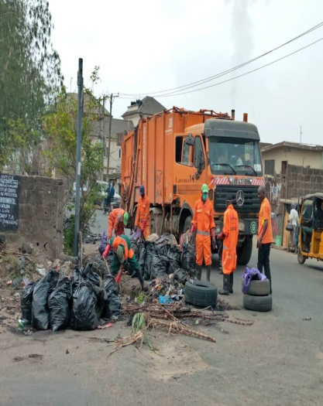
Office of the Environmental Services
LAGOS WASTE MANAGEMENT AUTHORITY (LAWMA)
LAWMA officials evacuating waste at 4am.
.
LAWMA officials evacuating waste from the streets of Lagos

Slide 47
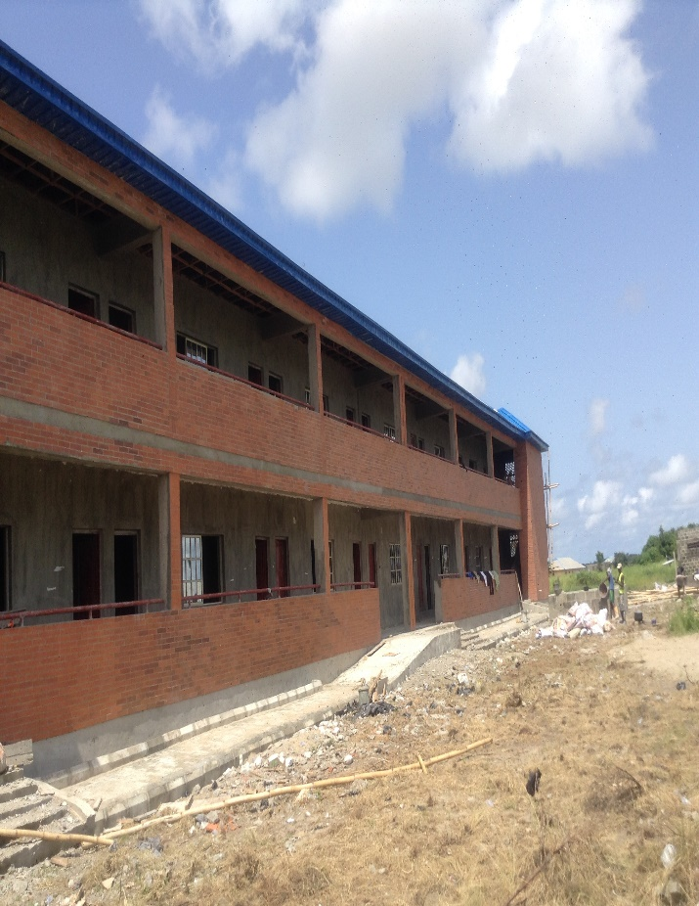
CONSTRUCTION OF 12 CLASSROOMS BLOCK AT ITUN-AGAN COMMUNITY GRAMMAR SCHOOL,AMUWO ODOFIN.LAGOS

Slide 48
CONSTRUCTION OF CLASSROOMS BLOCK AT MUSLIM JUNIOR COLLEGE EGBE

Slide 49
Commissioning of Police Command, Elemoro

Slide 50
Launching of “EKO EXCEL, Programme

Slide 51
CONSTRUCTION OF NEW BLOCK OF CLASSROOMS

Slide 52
Recruitment of Teachers

Slide 53
Completion of LAGOSHOMS Project, Igbogbo

Slide 54
Conclusion
In view of the dwindling revenues of the State due to the Pandemic, LASG is committed to growing the State’s IGR to be able to sustain its developmental programmes/projects.
We will continue to minimise wastages through tighter expenditure controls and promote prudent spending.
The administration of Mr. Babajide Sanwoolu is committed to particpatory and all inclusive governance process.
Consequently, you are all invited to provide your comments on our budget performance and suggestions on preferred focus areas for State in the coming year.

